Slide 1
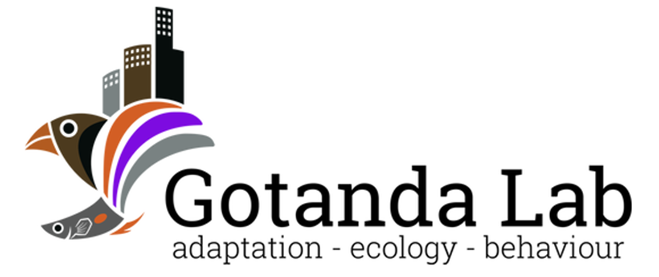

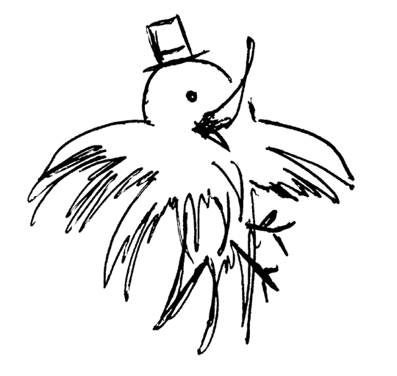
Heads Up!
Social Vigilance Behavior in American Crows
Alex Popescu
SQEBC 2022
Brock University

Slide 2
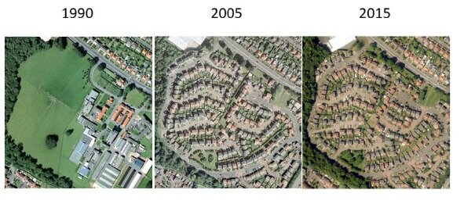
Urbanization
The shift in human population from rural to urban areas
An example of urbanisation in Edinburgh 1990 to 2015 Credit: CEH
Notes:
Rural != natural

Slide 3
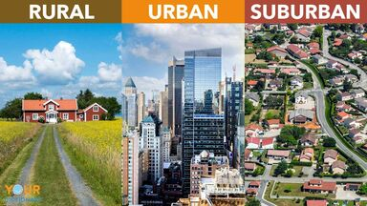
L'urbanisation
Leads to changes in the environment:
↑ Impermable surfaces
↑ Human-animal interactions
↓ Green spaces
Has negative effects on many species; associated with the global loss of biodiversity
https://examples.yourdictionary.com/identifying-difference-between-rural-urban-suburban
Kowarik I. 2011 Novel urban ecosystems, biodiversity, and conservation. Environ. Pollut. 159

Slide 4
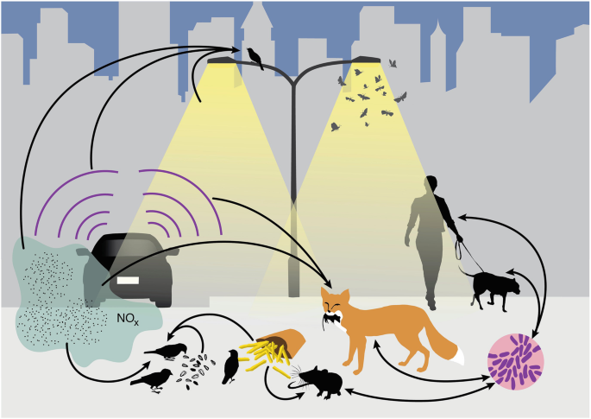
Can species be successful in cities?
Yes!*
* Will depend on species’ traits
Advantageous traits:
Adaptability
A generalist nature
An omnivorous diet
Intelligence
Isaksson, C. (2018). Impact of Urbanization on Birds. In: Tietze, D. (eds) Bird Species
Patankar S et al. 2021 Which Traits Influence Bird Survival in the City? A Review. Land 10

Slide 5
Can species be successful in cities?
Adapted behaviors are advantageous
Modified diet
↑ Interspecific aggression
↑ Human tolerance
↑ Tolerance of risks
Isaksson, C. (2018). Impact of Urbanization on Birds. In: Tietze, D. (eds) Bird Species
Luniak M. 2004 Synurbization - adaptation of animal wildlife to urban development. 50–55

Slide 6
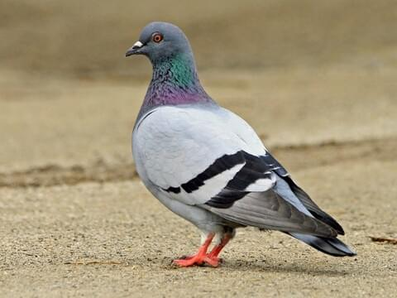
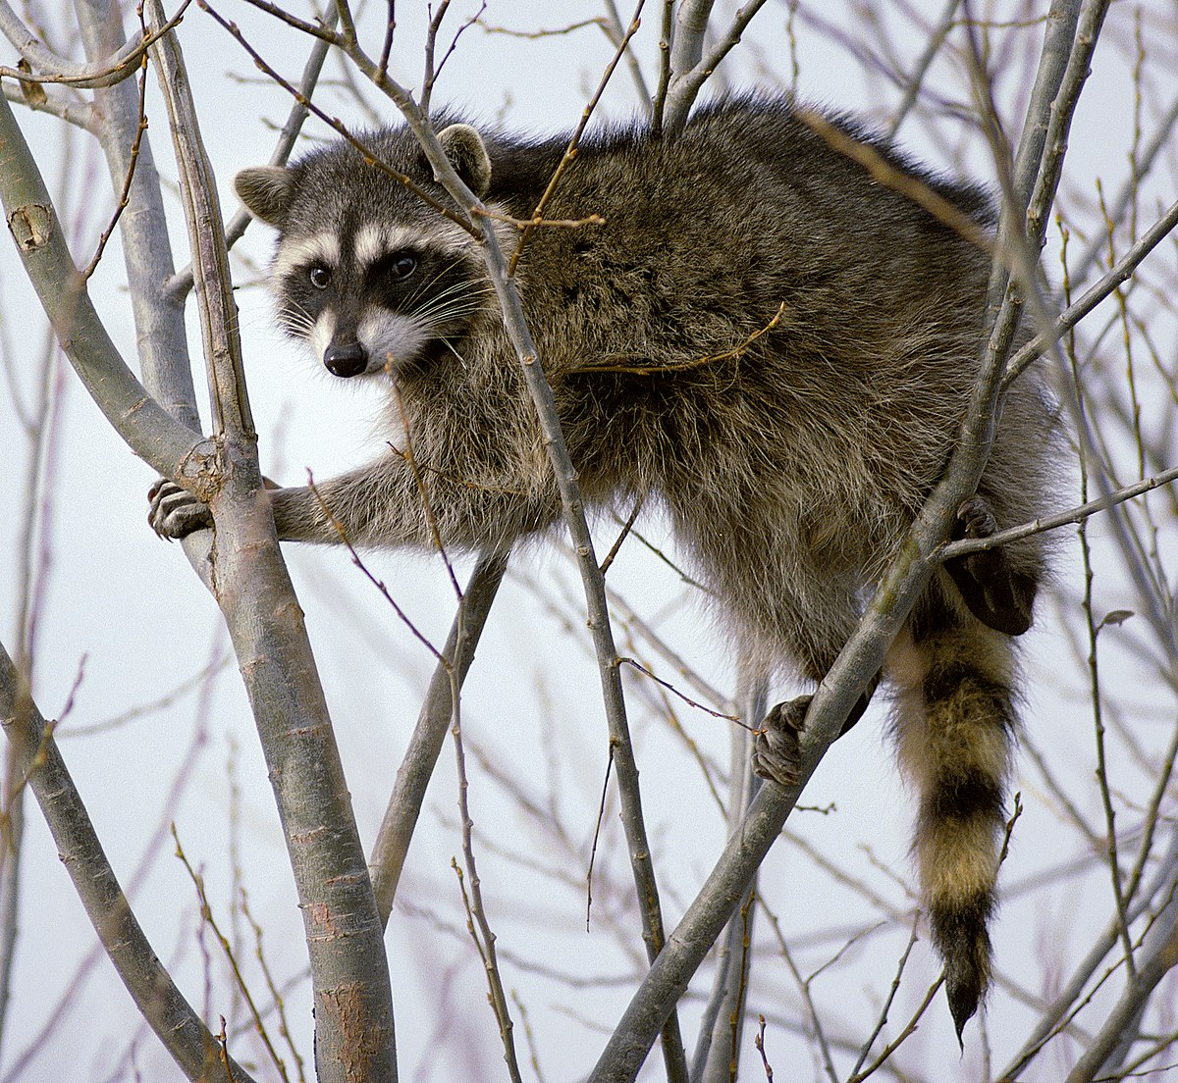
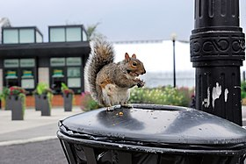
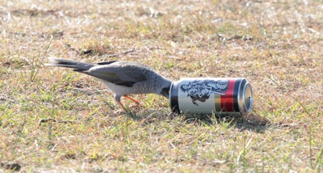
Urbanized species
Urbanisation ↑ = Abundance of urbanized species↑
Adaptable
Modified diet
Modified nesting
Generalists
Adapted behaviors

Slide 7
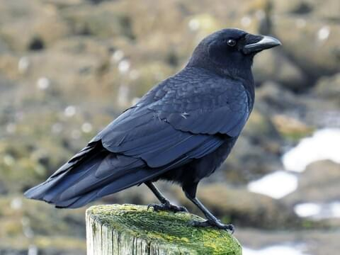

What about American crows?
Adaptable
Generalist
Intelligent
Adapted behaviors
Social?

Slide 8
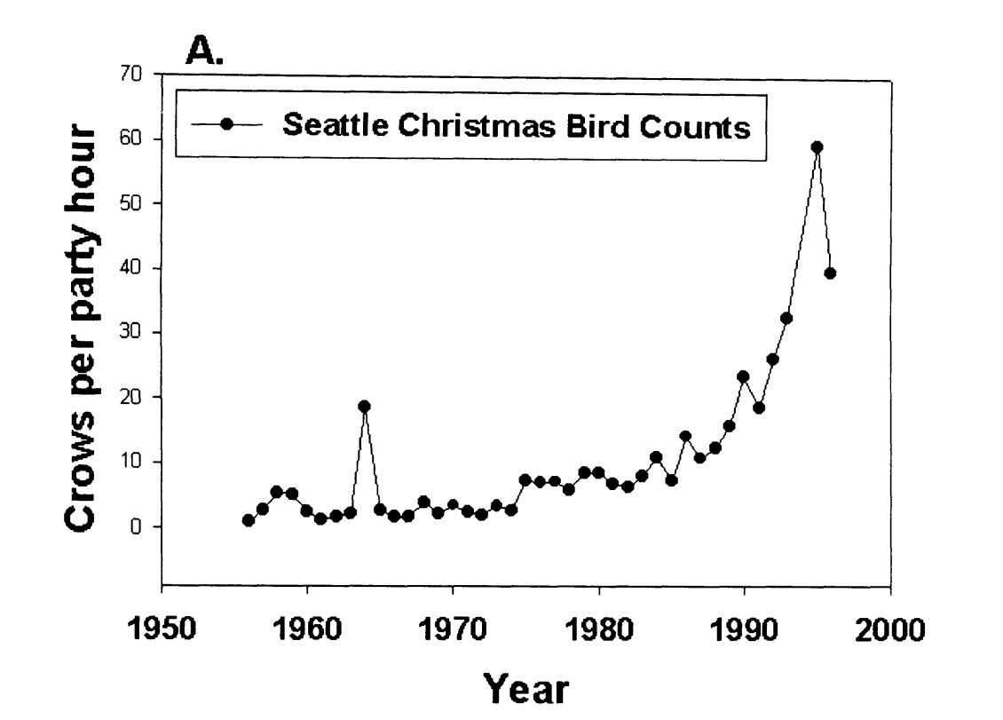
American crows in urban areas
Does the social nature of American crows contribute to their success in urban areas?
Crows spotted per hour
Marzluff et al.(2001). Avian Ecology and Conservation in an Urbanizing World || Causes and consequences of expanding American Crow populations.
Notes:
Explain numbers

Slide 9
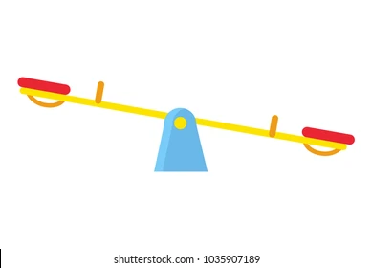

Vigilance and social foraging behavior
A trade-off between vigilance and foraging efficiency
Too much is like not enough
Social behaviors affect this tradeoff
Group foraging
Sentinel behavior
Vigilance
Foraging efficiency
Notes:
Individual level tradeoffs => tradeoff changes with social behavior

Slide 10
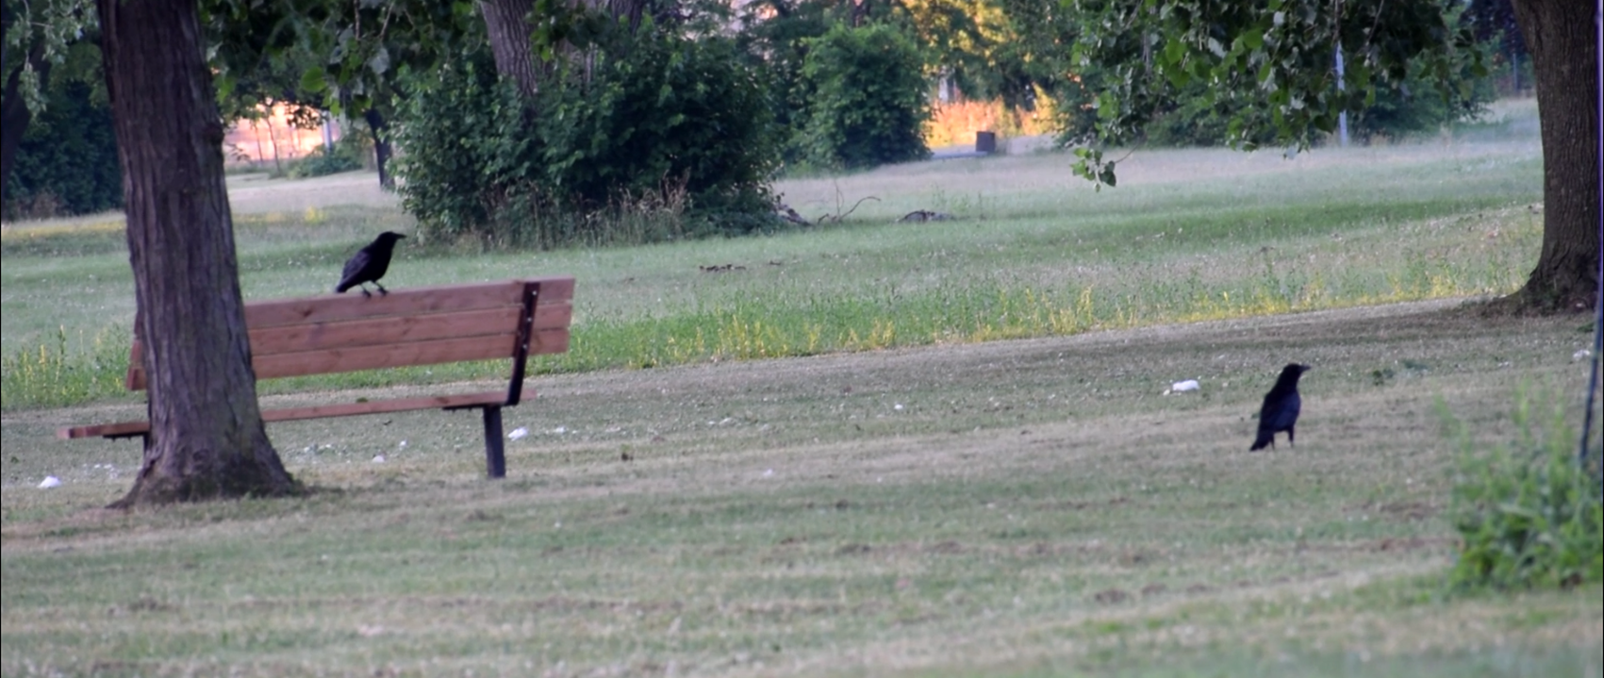
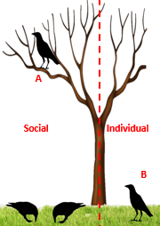
Sentinels
The sentinel (A) ensures the protection of foraging group-members through constant vigilance.
Costly behavior to the sentinel, but very beneficial to foragers.
The presence of a sentinel is expected to reduce the vigilance of foragers.
Notes:
Prediciton:

Slide 11
My objective
Determine if an individual’s foraging vigilance affected by the presence of a sentinel and the environment in which it forages in.
The modified use of sentinel behaviors is understudied.
Could explain, in part, the success of American crows in urban areas.

Slide 12
Methods
Testing sites were selected through a community science initiative: Crowkémon Go
Sites were visited regularly in the morning or evening
Sites were baited using different types and amounts of food
Foraging bouts were recorded from a distance and coded at a later date

Slide 13
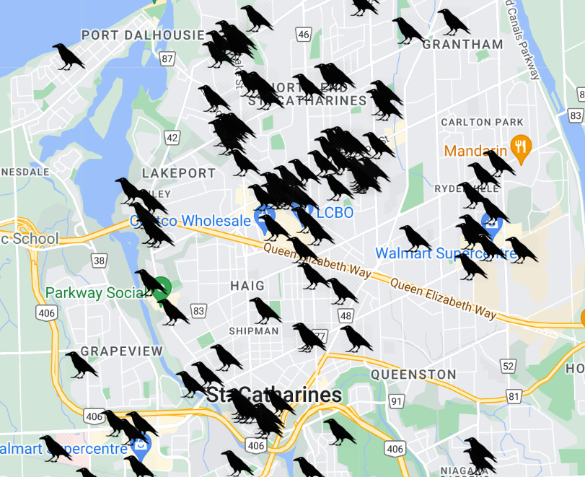
Crowkemon Go
Started in Jan 2022
Citizens across the Niagara region were invited to mark the locations of crows.

Slide 14
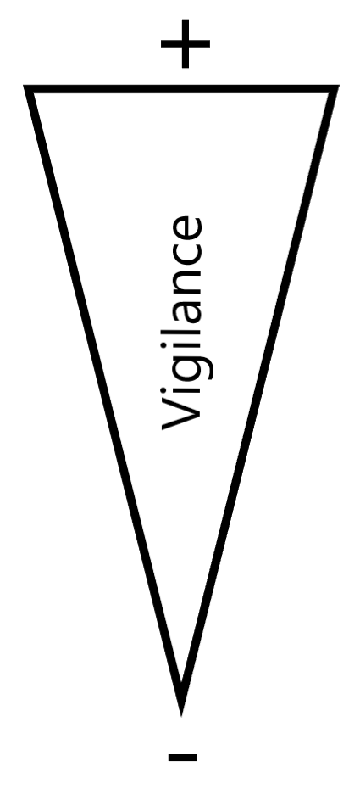
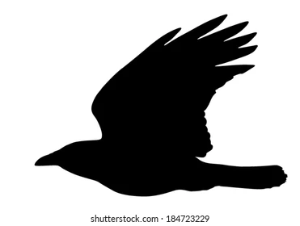
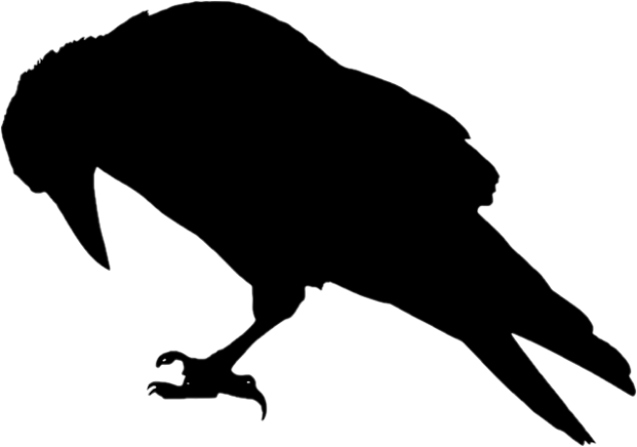
Methods
Alert
Moving
Foraging
Notes:
Make image with behaviors

Slide 15
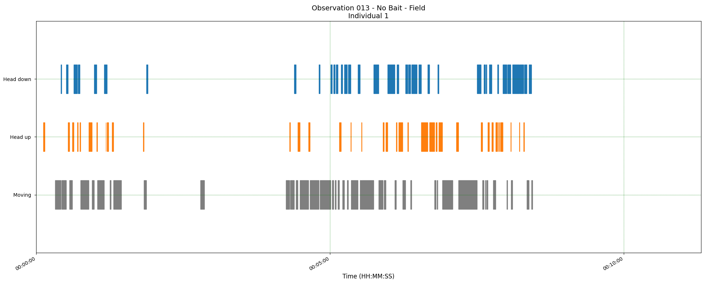
Methods
Three measurements:
The proportion of time allocated to each behavior
Peck rate
Duration of bouts
Foraging
Alert
Moving
Time

Slide 16
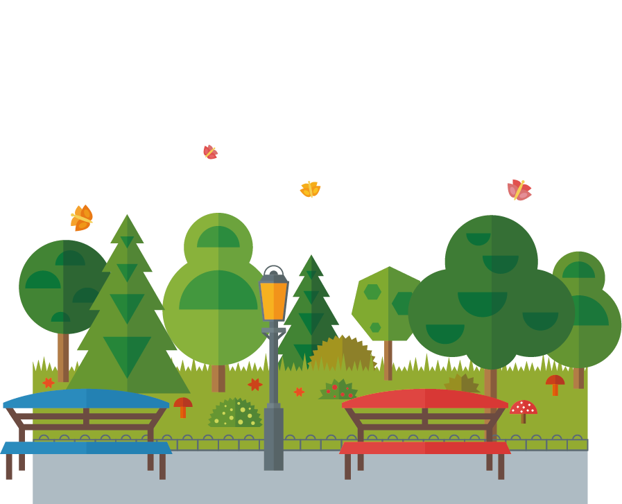

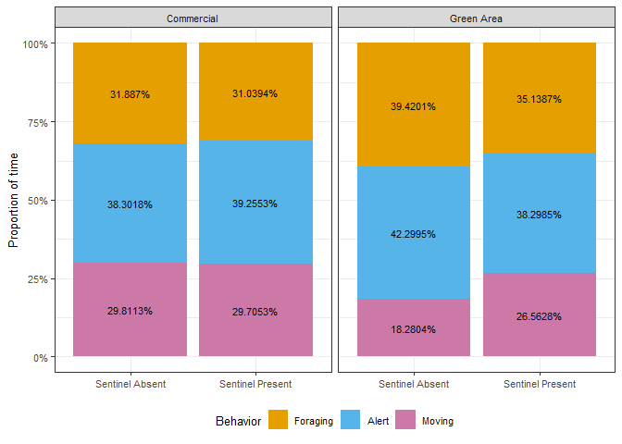
Proportion of time
Contrary to my predictions, there were no significant effects!
Proportion of foraging time

Slide 17
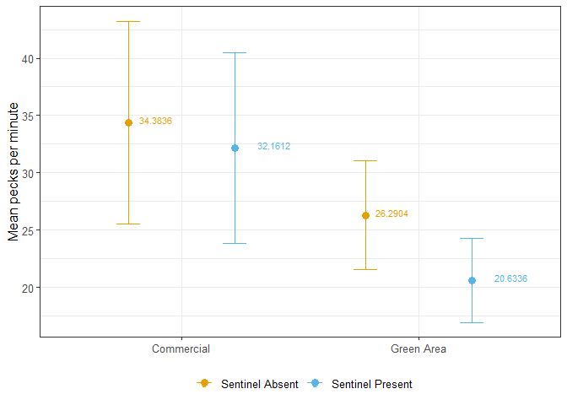
Peck rate
A measurement of foraging efficiency.
Once again, contrary to my predictions, there were no significant effects!

Slide 18
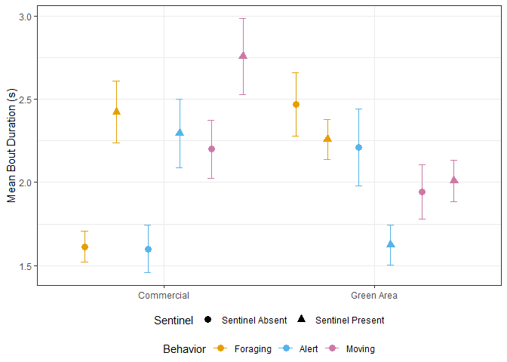
Bout duration
Mean bout duration (s)
Sentinel
Absent
Present
Behavior
Notes:
Explain plots first, then bring in data

Slide 19
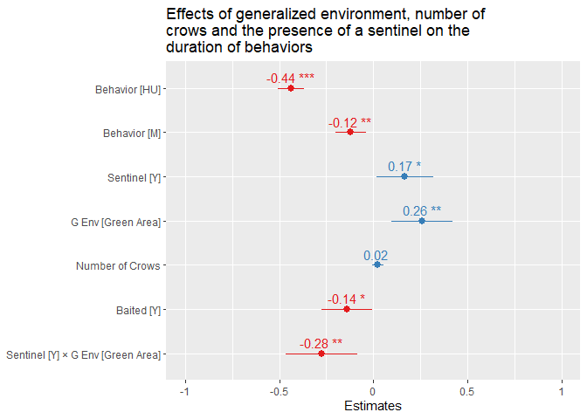
Effect sizes

Slide 20
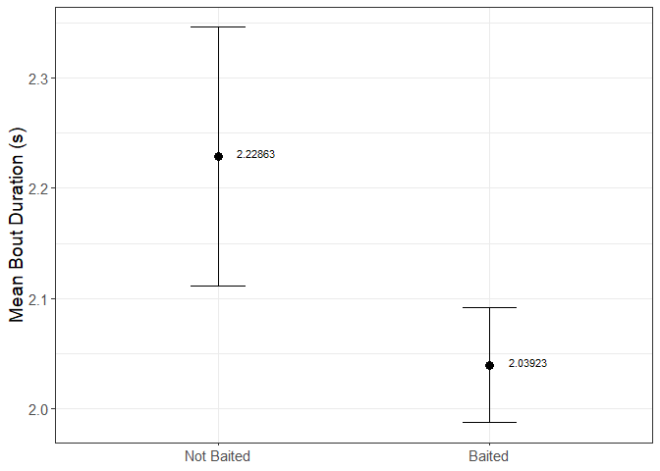
Bait
Baited sites had considerably decreased duration of bouts.
Concentrated, food dense patches
Less time looking for and handling food

Slide 21
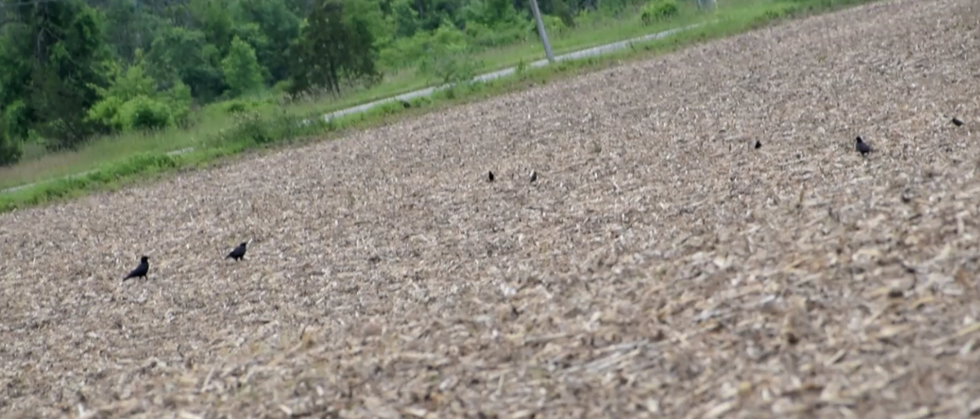
Some caveats
It is impossible to tell what the crows are looking at when being alert:
Looking for threats and predators
Other species
Other crows
Did they find something?

Slide 22
Conclusions
My initial hypotheses are not fully supported by my results
No significant effect on the proportion of time allocated to each behavior or peck rate.
The presence of a sentinel and the environment in which the crow forages in have significant effects on duration of bouts.
Do you want to know more?

Slide 23

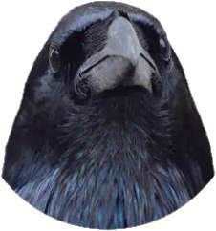
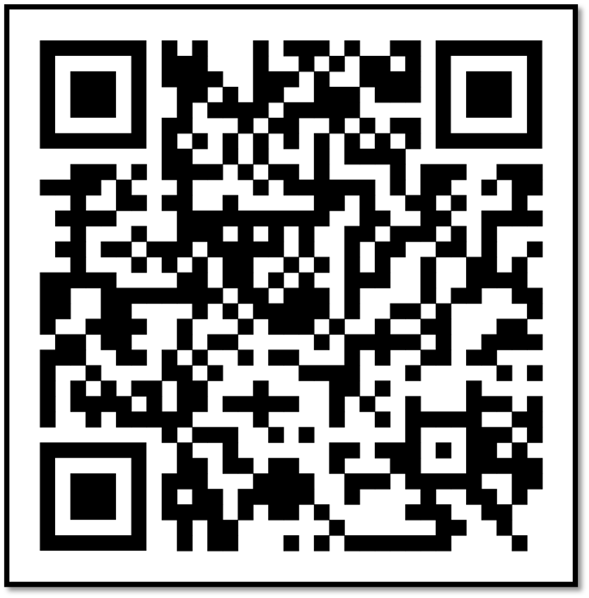

Crowkémon Go

Slide 24

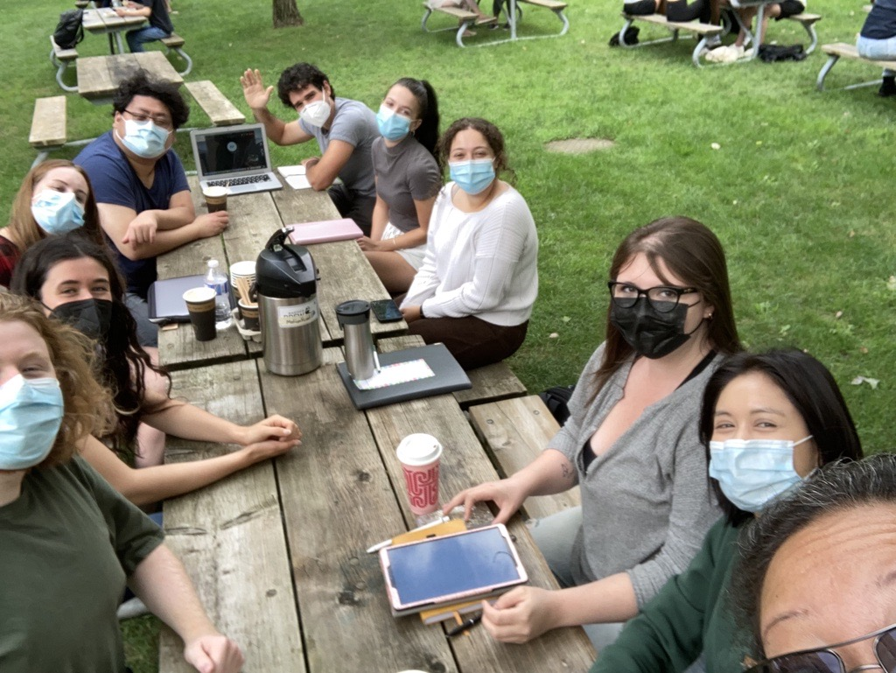

Aknowledgements
My supervisors: Dre. Kiyoko Gotanda, Dre. Liette Vasseur, Dre. Anne Clark
The Gotanda Lab
My family and friends

Slide 25
Questions?

